Slide 1
Learning Objective
I will be able to graph exponential functions involving Euler’s number
Success Criteria
At the end of the lesson, I will be able to:
Graph exponential functions involving Euler’s number
Graph transformations of exponential functions involving Euler’s number

Slide 2



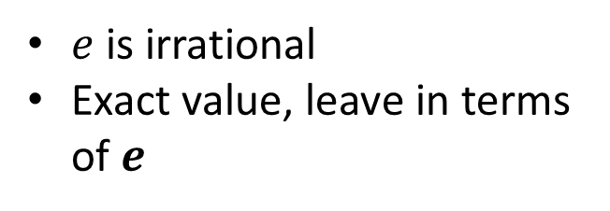





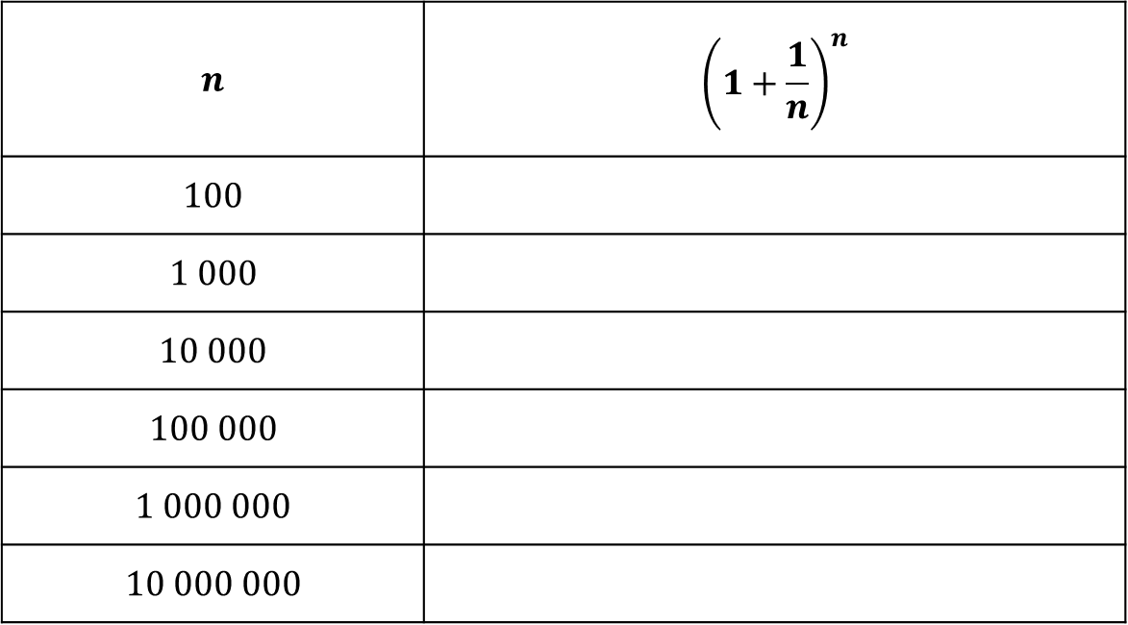

Understanding $e$
Introducing:
$$f\left(x\right)=e^{x}$$
Where $e$ is Euler’s number and
$$e=\lim_{n→∞}{{\left(1+\frac{1}{n}\right)}^{n}}$$
$$≈2.71828$$
$$n$$ | $${\left(1+\frac{1}{n}\right)}^{n}$$
$$100$$
$$1 000$$
$$10 000$$
$$100 000$$
$$1 000 000$$
$$10 000 000$$
$e$ is irrational
Exact value, leave in terms of $e$
$${\left(1.01\right)}^{100}=2.704 813$$
$${\left(1.001\right)}^{1000}=2.716 923$$
$${\left(1.0001\right)}^{10000}=2.718 145$$
$${\left(1.000 01\right)}^{100000}=2.718 268$$
$${\left(1.000 001\right)}^{1000000}=2.718 280$$
$${\left(1.000 000 1\right)}^{10000000}=2.718 282$$

Slide 3
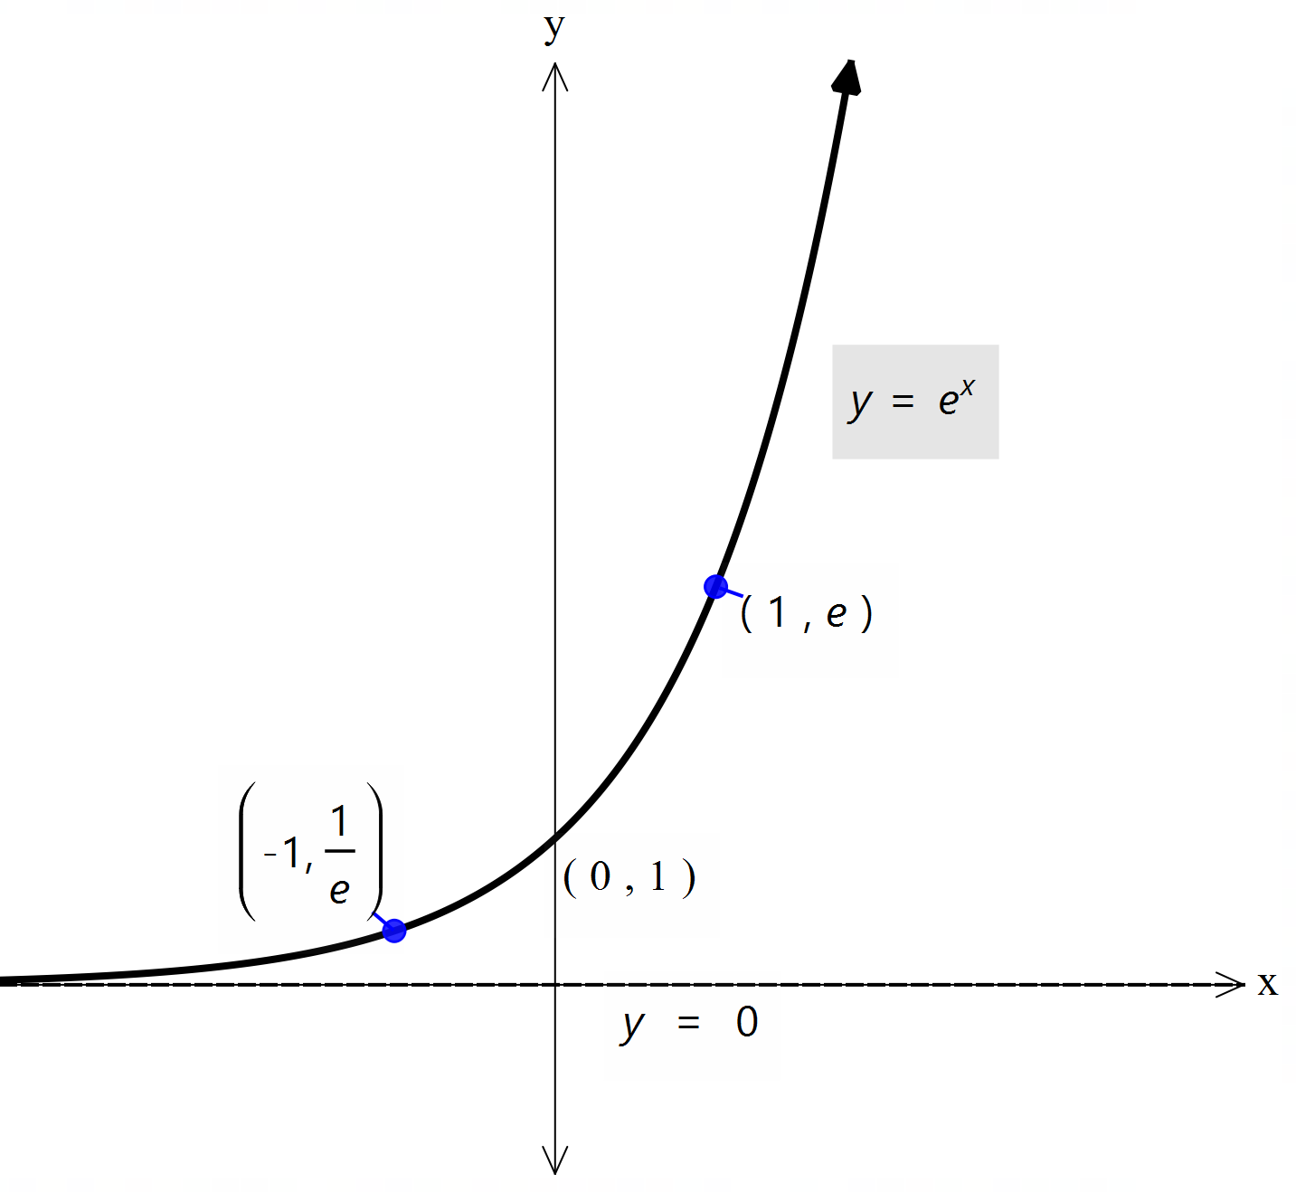
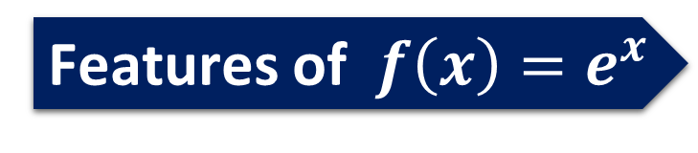
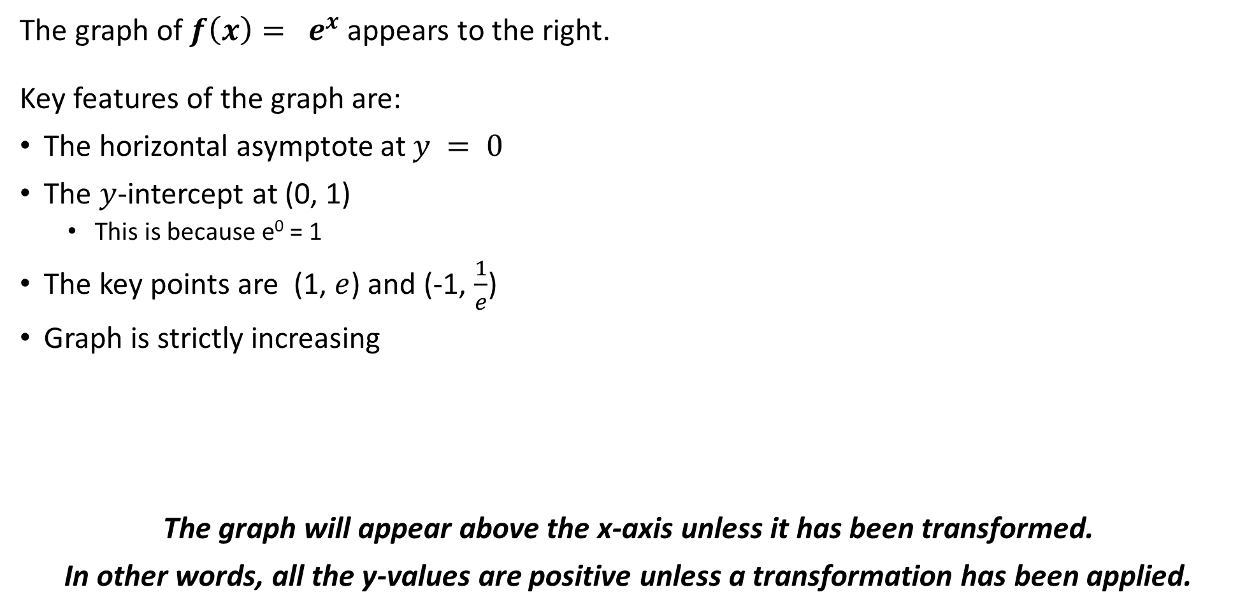
Features of $f\left(x\right)=e^{x}$
The graph of $f\left(x\right)= e^{x}$appears to the right.
Key features of the graph are:
The horizontal asymptote at $y = 0$
The $y$-intercept at (0, 1)
This is because e⁰ = 1
The key points are (1, $e$) and (-1, $\frac{1}{e}$)
Graph is strictly increasing
The graph will appear above the x-axis unless it has been transformed.
In other words, all the y-values are positive unless a transformation has been applied.

Slide 4
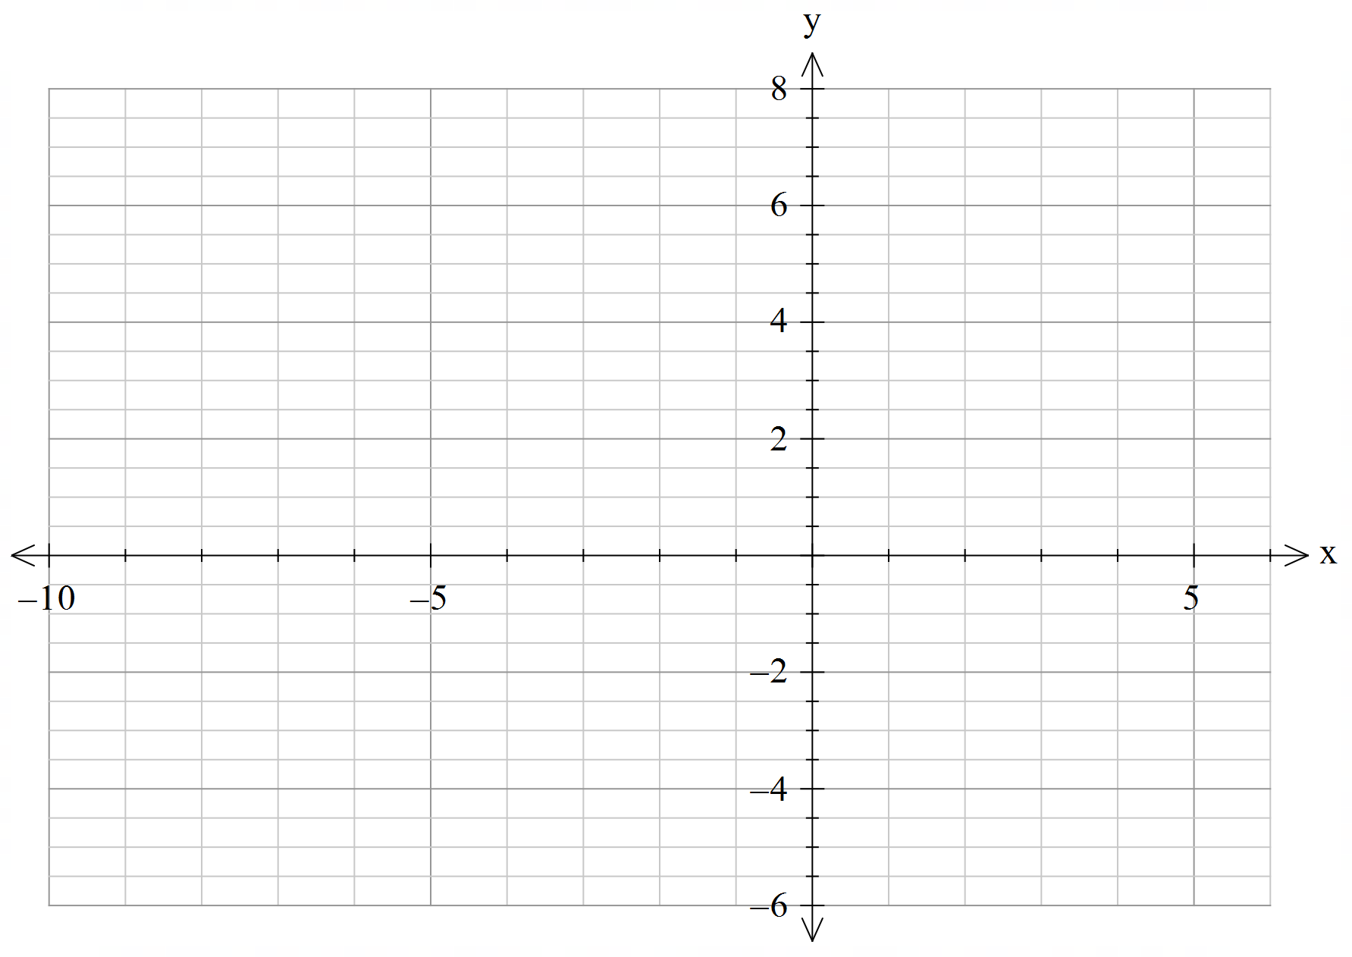
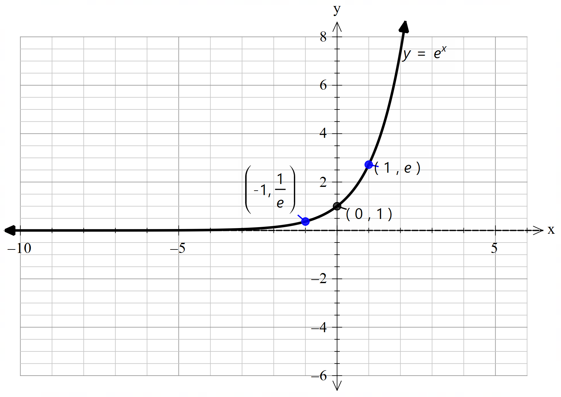
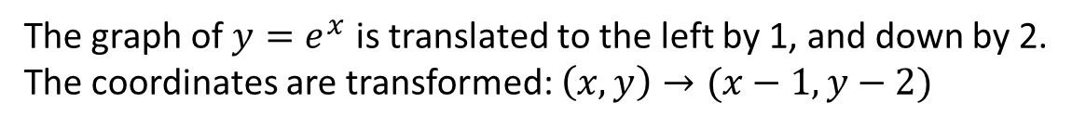
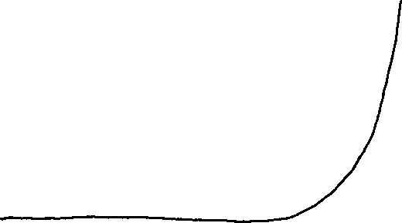
Guided Practice
The graph of $y=e^{x}$ is translated to the left by 1, and down by 2.
The coordinates are transformed: $\left(x,y\right)→(x−1,y−2)$
Sketch the graph $y=e^{x+1}−2$

Slide 5
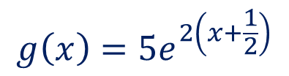
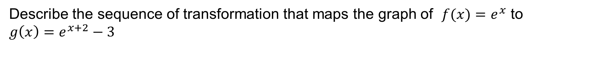
Guided Practice
Describe the sequence of transformation that maps the graph of $f(x)=e^{x}$ to
$g\left(x\right)=e^{x+2}−3$
The graph of $f(x)=e^{x}$ is translated to the left by 2 units, and down by 3 units.
Describe the sequence of transformation that maps the graph of $f(x)=e^{x}$ to
$g\left(x\right)=2−e^{x−1}$
The graph of $f(x)=e^{x}$ is reflected about the x-axis, translated to the right by 1 unit, and up by 2 units.
Describe the sequence of transformation that maps the graph of $f(x)=e^{x}$ to
$g\left(x\right)=5e^{2x+1}$
$$g\left(x\right)=5e^{2\left(x+\frac{1}{2}\right)}$$
The graph of $f(x)=e^{x}$ is dilated parallel to the y-axis by a factor of 5, and dilated parallel
to the x-axis by a factor of $\frac{1}{2}$ followed by a translation to the left by $\frac{1}{2}$

Slide 6

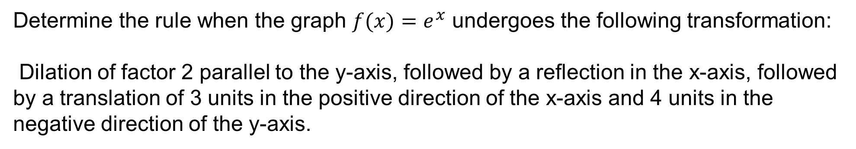


Guided Practice
Determine the rule when the graph $f(x)=e^{x}$ undergoes the following transformation:
Dilation of factor 2 parallel to the y-axis, followed by a reflection in the x-axis, followed by a translation of 3 units in the positive direction of the x-axis and 4 units in the negative direction of the y-axis.
$$2f(x)={2e}^{x}$$
$$−2f\left(x\right)=−{2e}^{x}$$
$$−2f\left(x−3\right)−4=−{2e}^{x−3}−4$$

Slide 7

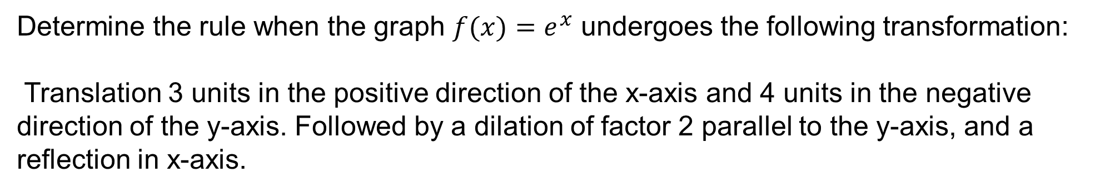
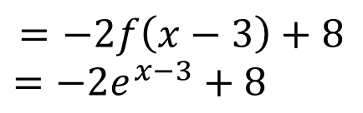

Guided Practice
Determine the rule when the graph $f(x)=e^{x}$ undergoes the following transformation:
Translation 3 units in the positive direction of the x-axis and 4 units in the negative direction of the y-axis. Followed by a dilation of factor 2 parallel to the y-axis, and a reflection in x-axis.
$$f\left(x−3\right)−4=e^{x−3}−4=g(x)$$
$$−2\left(g\left(x\right)\right)=−2(f\left(x−3\right)−4)$$
$$=−2f\left(x−3\right)+8$$
$=−{2e}^{x−3}+8$

Slide 8
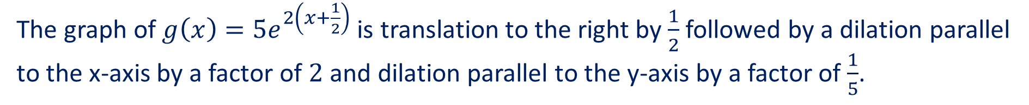
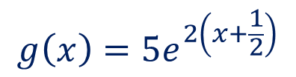
Guided Practice
Describe the sequence of transformation that maps the graph of $g\left(x\right)=e^{x+2}−3$ to $f(x)=e^{x}$
The graph of $g\left(x\right)=e^{x+2}−3$ is translated to the right by 2 units, and up by 3 units.
Describe the sequence of transformation that maps the graph of $g\left(x\right)=2−e^{x−1}$ to of $f(x)=e^{x}$
The graph of $g\left(x\right)=2−e^{x−1}$translated to the left by 1 unit and down by 2 units
Followed by reflection about the x-axis,
Describe the sequence of transformation that maps the graph of $g\left(x\right)=5e^{2x+1}$ to $f(x)=e^{x}$
$$g\left(x\right)=5e^{2\left(x+\frac{1}{2}\right)}$$
The graph of $g\left(x\right)=5e^{2\left(x+\frac{1}{2}\right)}$is translation to the right by $\frac{1}{2}$ followed by a dilation parallel
to the x-axis by a factor of $2$ and dilation parallel to the y-axis by a factor of $\frac{1}{5}$.

Slide 9
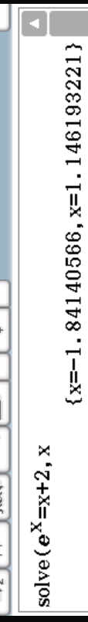

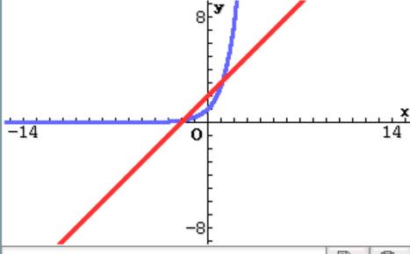

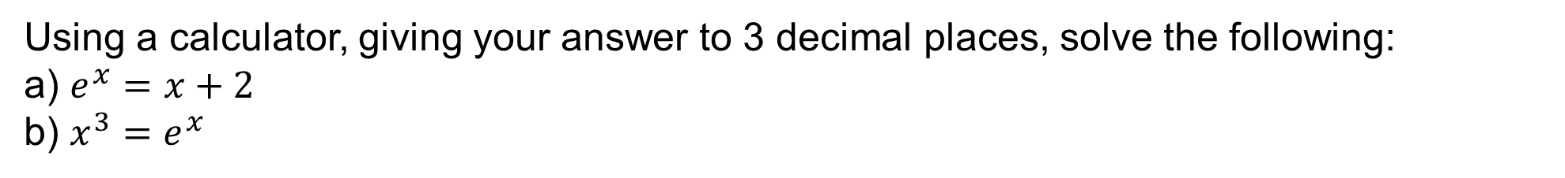

Guided Practice
Using a calculator, giving your answer to 3 decimal places, solve the following:
a) $e^{x}=x+2$
b) $x^{3}=e^{x}$
$$x=−1.841, 1.146$$
Why do we have 2 solutions?
b) How many solutions would we have?
$$x=1.857, 4.536$$

Slide 10
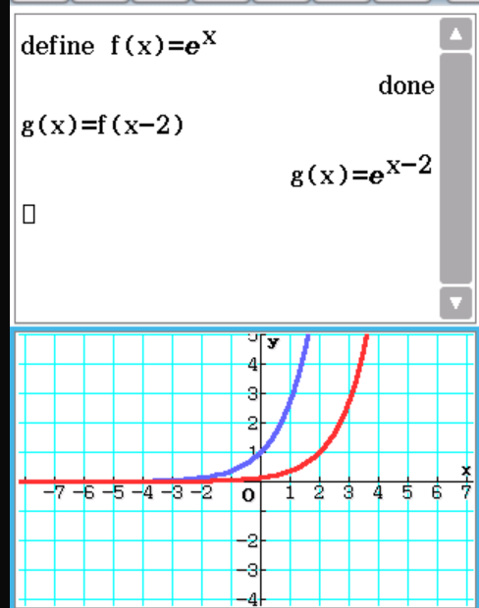
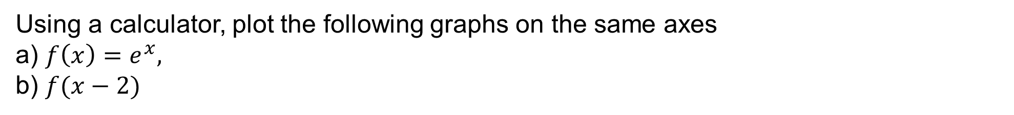
Guided Practice
Using a calculator, plot the following graphs on the same axes
a) $f\left(x\right)=e^{x},$
b) $f(x−2)$

Slide 11
Independent Practice
Cambridge Ex 2B

